Slide 1
RFM Analysis
Onur AKCAKAYA

Slide 2
RFM- Customer Segmentation
Business Problem
Data Story
Variable Description
Aim
Method
Results
Recommendations

Slide 3

1-Business Problem
An UK based e-commerce company want to divide their customers into segments and develop Marketing strategies according to this segmentation results

Slide 4
2-Data Story
The dataset “Online Reatil II” contains transation records of an UK based e-commerce store between 12.01.2019-12.09.2011
Items listed are souvenirs also can be considered as promotional items
Majority of the customers are wholesale traders

Slide 5
3-Variables
InvoiceNo: Unique number for each transaction. “C” noted infront means the transaction is cancelled
StockCode: Unique code for each item
Description: Item name and description
Quantity: Quantity of the goods listed in the invoice
InvoiceDate:Date and time of the invoice
UnitPrice:Unit price of the goods listen in each invoice
CustomerID: Unique ID for each customer
Country: Name of the country where the customer is located

Slide 6

4-AIM
Aim of the project is to define customer behaviors and forming groups according to these behaviors

Slide 7
5-METHOD
Dataset obtained from: https://archive.ics.uci.edu/ml/machine-learning-databases/00502/
Missing values and “Cancelled” transactions are dropped from the data set
TotalPrice column created for each invoice by using “Price” and “Quantity” Columns
Recency column created by using the transaction time.
Frequency column created by using the total number of transaction made by each customer
Monetary column created by using the TotalPrice of each customer
Recency, Frequency and Monetary values dived into score of 1 to 5 where 1 is worst and 5 is best*
RFM score is obtained by combining Recency, Frequency and Monetary Ratings
Each group named as the following graphic
*- Receny value 5 is most recent and 1 least recent

Slide 8
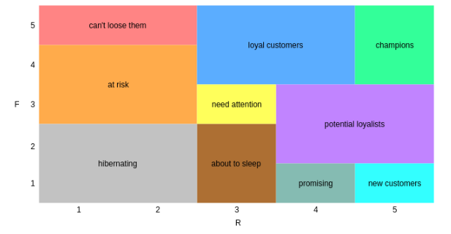
6-Method
Each group named according to their RF score with respect to the graph above
Most frequent and recent customers labelled as champions where the least are labelled as hibernating

Slide 9
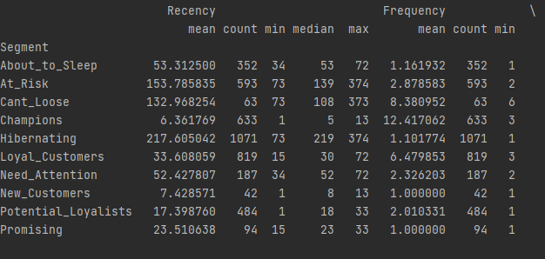
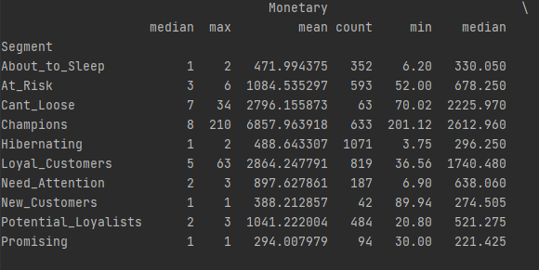
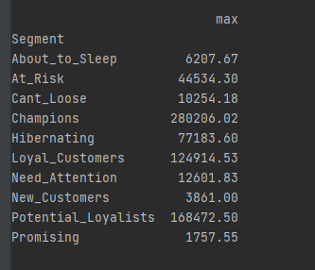
7-Result
6-Result
For the “Need_Attention” segment, the recency value is 52.4 with mean monetary value of 897.6 £. This Group need to be stimulated to shorten recency values, therefore. Momentarily discounts can be e-mailed to push them make their purchase earlier
For the “At_Risk” segment, a large group of 593 customers, their monetary median is similar to “Need_Attention” group. This group is tend to go down so in order to attract them, longer discount period can be applied. By this way, they can make more one purchase with desicount price imporving the recency score
For the “Cant_Loose” segment, them median monetary values is similar to “Champions”. Aggressive marketing can improve their recency score and hence transform them to upper segments

Slide 10

7-Recommendations
“Champions” and “Loyal_Customers” are the largest groups that the company makes the most revenue. To make them happy sending promotions can be a good idea. By this way customer loyalty can be assured
Loyalty programs can be offered to the all groups. Especially “New Customers” group are paying high amounts, loyalty among this group should be maintained. ”Potential Loyalists” can be improved by this method as well
Good customer service can also improve the loyalty, so the a good “Cancellation” and “Return” policy can be deployed to maintain loyalty.

